Slide 1
SESSION 24
Language Models
From counting words to ChatGPT — how machines learned to predict the next word
P(wₜ | w₁, w₂, …, wₜ₋₁)
Theory + Discussion · ~1.5 hours · Computer Vision & AI Course

Slide 2
Today's Agenda
One story in two acts: before transformers, and after
PART 1 · THE FOUNDATIONS | ~45 min
PART 2 · THE TRANSFORMER ERA | ~45 min
What is a language model, really?
N-gram models: language as counting
Why counting breaks down
Neural language models (Bengio, 2003)
The pretraining revolution
Autoregressive models: GPT — predict the next token
Masked models: BERT — fill in the blanks
T5: everything is text-to-text
GPT vs BERT vs T5 — when to use which
The road to ChatGPT + recap
Session 24 · Language Models
2

Slide 3
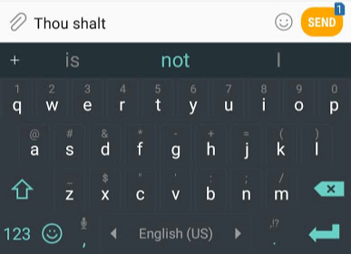
What Is a Language Model?
A probability distribution over sequences of words
You already use one every day.
Your phone keyboard suggests the next word as you type — that is a language model at work.
A language model assigns a probability to a sequence of words.
Equivalently: given the words so far, it predicts what comes next.
P(“the cat sat on the mat”) should be high. P(“mat the on sat cat the”) should be tiny.
Every model today — GPT, BERT, T5 — is an answer to one question: how do we estimate these probabilities?
Image: Jay Alammar, “The Illustrated Word2vec” (CC BY-NC-SA 4.0)
Session 24 · Language Models
3

Slide 4
N-gram Language Models
The first idea: just count how often word pairs appear
Markov assumption: the next word depends only on the last n−1 words — not the whole history.
Bigram (n=2): P(next | previous word)
Trigram (n=3): P(next | previous two words)
Estimate by counting in a large corpus — no learning, just statistics.
State of the art for ~30 years: speech recognition, translation, autocomplete.
BIGRAM ESTIMATE, FROM COUNTS
P(food | want)
= Count(“want food”)
÷ Count(“want”)
“I want …”
food 0.32
to 0.28
the 0.11
zebra 0.0001
Session 24 · Language Models
4

Slide 5
Why Counting Breaks Down
Three walls that n-gram models could never climb
1
2
3
Sparsity
No generalization
Tiny context
Most word combinations never appear in any corpus. Unseen trigram → probability zero, even if perfectly sensible.
“Cat” and “dog” are unrelated symbols. Seeing “the cat sleeps” teaches nothing about “the dog sleeps”.
n rarely exceeds 5 — the model literally cannot see past the last few words. Long-range meaning is invisible.
The fix for all three: stop treating words as symbols to count — represent them as vectors and learn.
Session 24 · Language Models
5

Slide 6
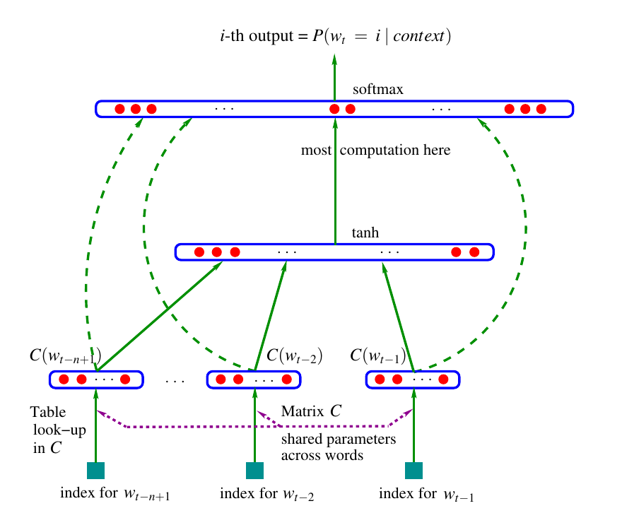
Neural Language Models (2003)
Bengio's idea: learn word vectors and the predictor together
Each context word → embedding vector (matrix C, shared across positions).
A neural network maps the context vectors to a softmax over the whole vocabulary.
Similar words get similar vectors → the model generalizes: “cat” evidence helps “dog”.
Solves sparsity and generalization — the two fatal n-gram flaws.
This paper is where word embeddings (Session 21!) were born — as a side effect of language modeling.
Figure: Bengio et al. (2003), “A Neural Probabilistic Language Model”, JMLR
Session 24 · Language Models
6

Slide 7
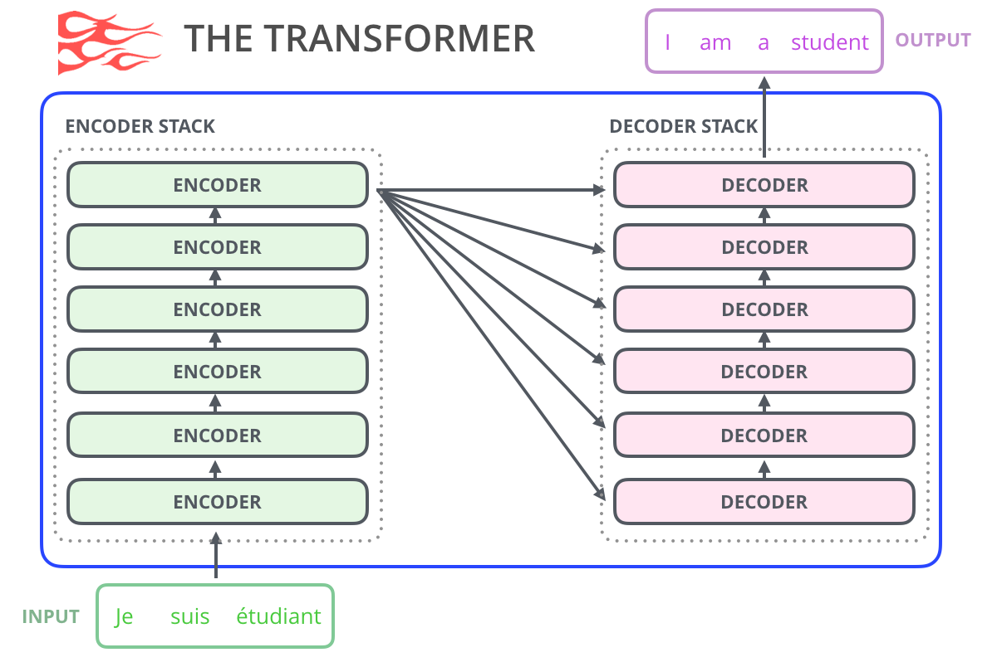
The Bridge We Already Built
Sessions 21–23 gave us every ingredient we need today
Session 21 — Word embeddings: words as vectors that capture meaning.
Session 22 — RNNs/LSTMs: neural LMs over long sequences, one word at a time. Better, but slow and forgetful.
Session 23 — Transformers: attention lets every word see every other word, all in parallel.
Today's models are transformers trained as language models — the encoder, the decoder, or both.
Image: Jay Alammar, “The Illustrated GPT-2” (CC BY-NC-SA 4.0)
Session 24 · Language Models
7

Slide 8
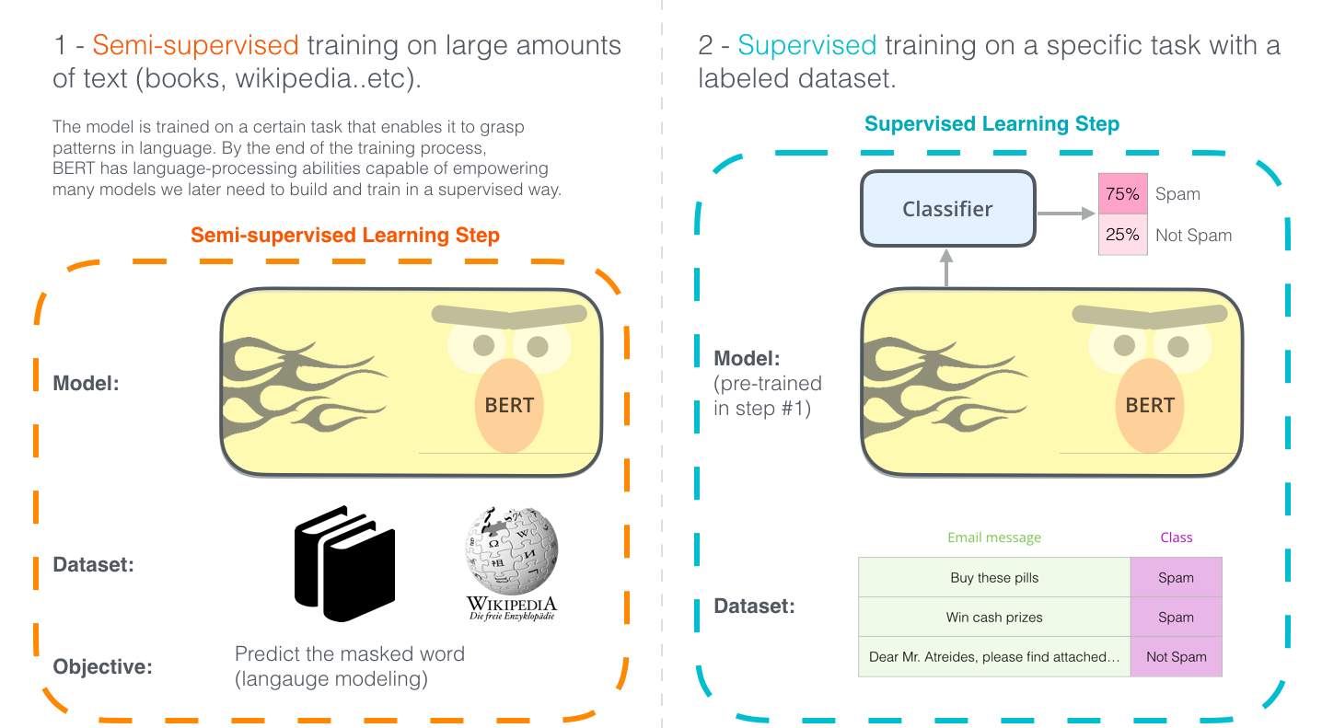
The Pretraining Revolution
Raw text is free — labels are expensive. Use the text itself as the teacher
Step 1 — Pretrain: train a huge model on billions of words of plain text. The task: predict words. No human labels needed.
Step 2 — Fine-tune: take that pretrained model and adapt it to your task (classification, QA, …) with a small labeled set.
Same recipe as ImageNet pretraining in computer vision — but the “labels” come free from the text.
The key design choice: WHAT exactly do we ask the model to predict?
Image: Jay Alammar, “The Illustrated BERT” (CC BY-NC-SA 4.0)
Session 24 · Language Models
8

Slide 9
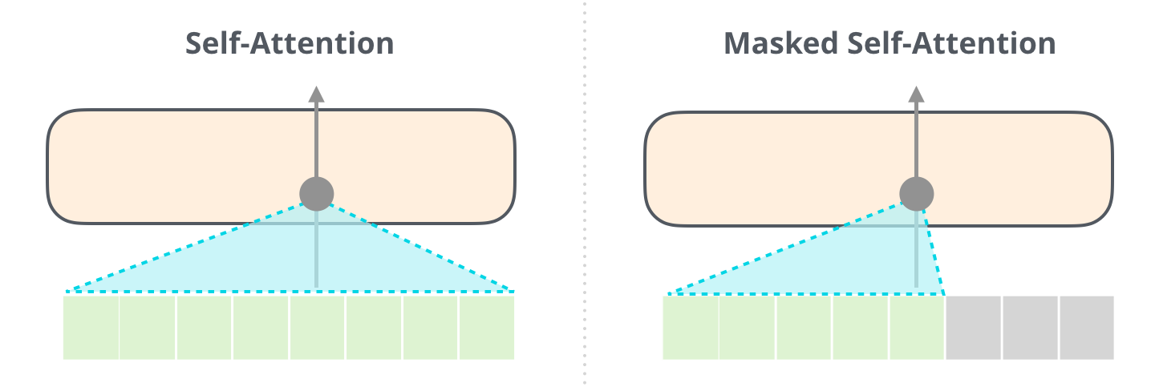
Two Ways to Learn From Raw Text
The fork in the road that defines GPT and BERT
Image: Jay Alammar, “The Illustrated GPT-2” (CC BY-NC-SA 4.0)
MASKED · “Fill in the blank” → BERT
AUTOREGRESSIVE · “What comes next?” → GPT
Sees the WHOLE sentence, some words hidden. Bidirectional — great at understanding.
Sees only the LEFT context, predicts the next token. Causal — great at generating.
Session 24 · Language Models
9

Slide 10
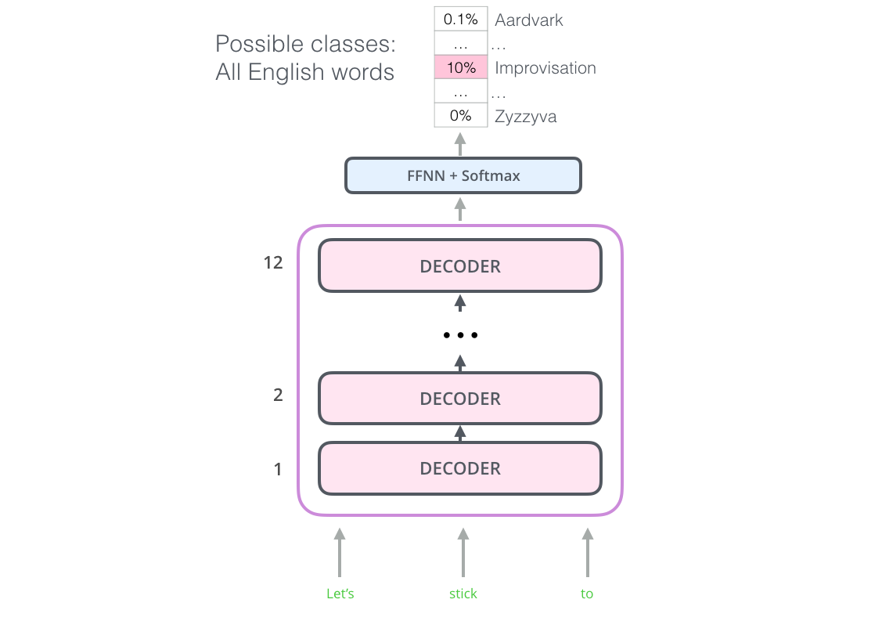
GPT: Autoregressive Language Models
A transformer decoder trained on one task — predict the next token
GPT (2018) = Generative Pre-trained Transformer: decoder blocks only.
Masked self-attention: each token may look left, never right — no cheating.
Output layer scores the entire vocabulary; softmax turns scores into P(next token).
Training data: just text. Every position in every sentence is a free training example.
One simple objective, at scale, produces a model that can write.
Image: Jay Alammar, “The Illustrated BERT” (CC BY-NC-SA 4.0)
Session 24 · Language Models
10

Slide 11
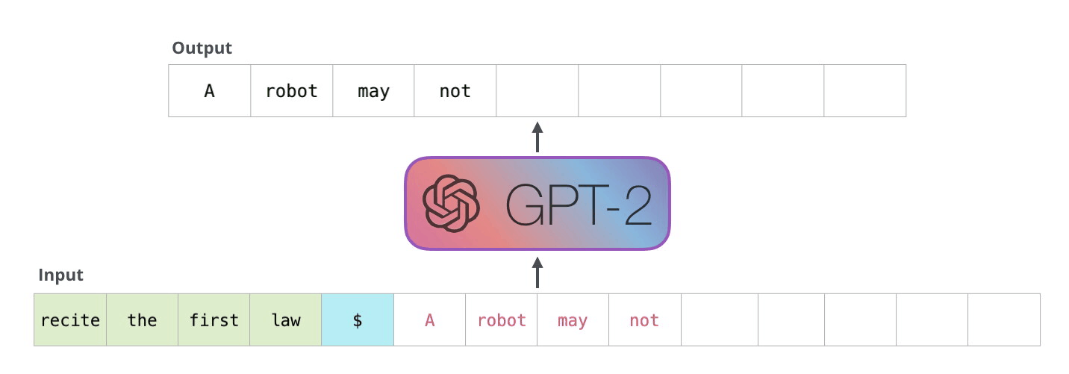
Autoregression: Generating Word by Word
The model's own output becomes its next input
Image: Jay Alammar, “The Illustrated GPT-2” (CC BY-NC-SA 4.0)
1 Feed the prompt into the model
2 Model outputs P(next token)
3 Pick one (sample or argmax)
4 Append it, repeat from step 1
Session 24 · Language Models
11

Slide 12
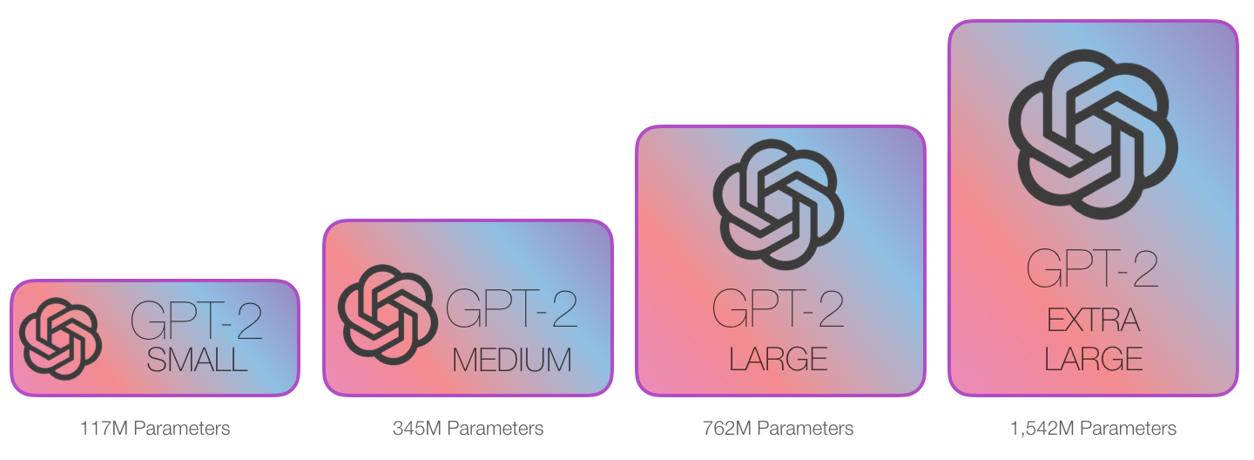
The Scaling Story
Same recipe, more of everything — and abilities kept emerging
Image: Jay Alammar, “The Illustrated GPT-2” (CC BY-NC-SA 4.0)
GPT-1 (2018): 117M params → GPT-2 (2019): 1.5B → GPT-3 (2020): 175B — a 1,000× jump in two years.
GPT-3 could do tasks from instructions alone (“in-context learning”) — no fine-tuning.
ChatGPT = a GPT model + instruction tuning + human feedback (RLHF). The core is still next-token prediction.
Session 24 · Language Models
12

Slide 13
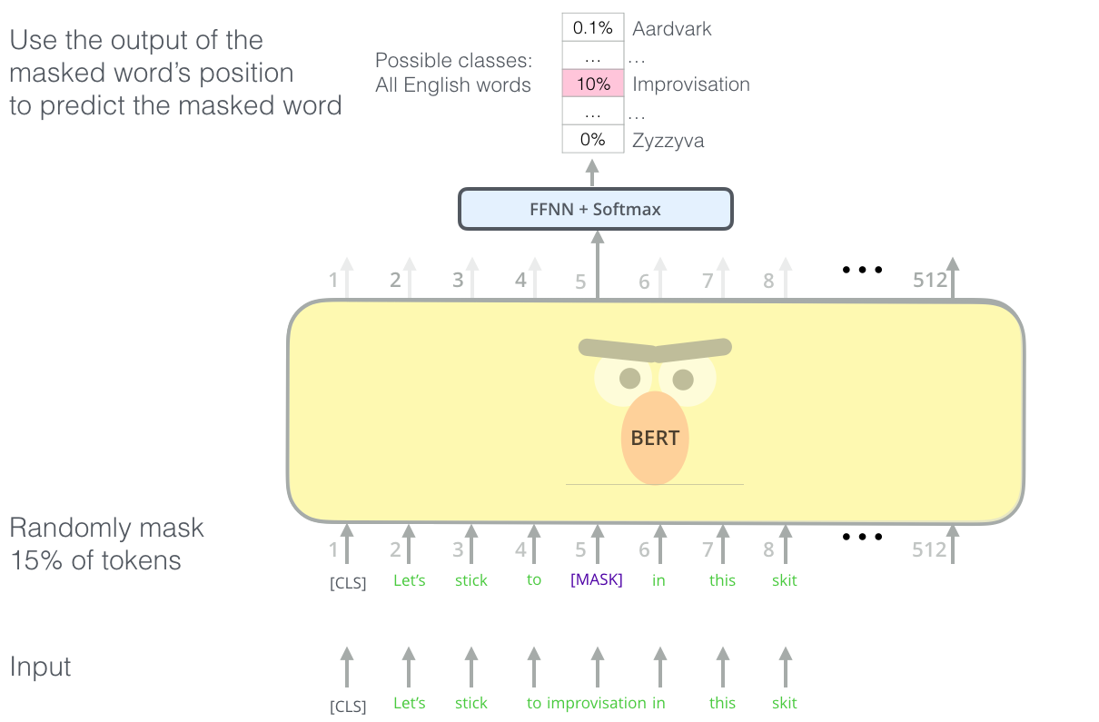
BERT: Masked Language Models
Hide 15% of the words — make the model fill in the blanks
BERT (2018) = Bidirectional Encoder Representations from Transformers: encoder blocks only.
Randomly mask 15% of input tokens; predict the originals from BOTH directions.
“The [MASK] sat on the mat” → context on both sides says “cat”.
Bidirectionality = deeper understanding, but BERT cannot generate text.
Second objective: Next Sentence Prediction — does sentence B follow sentence A?
Image: Jay Alammar, “The Illustrated BERT” (CC BY-NC-SA 4.0)
Session 24 · Language Models
13

Slide 14
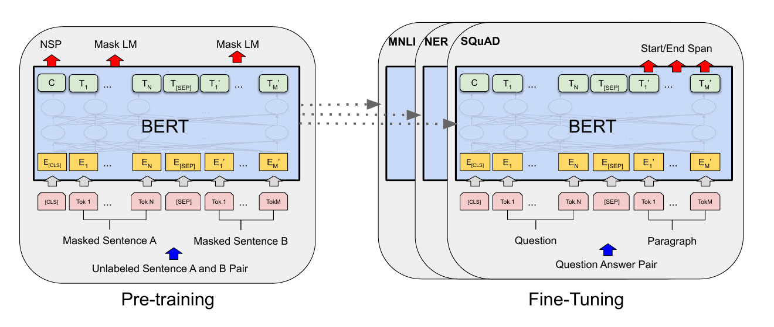
BERT: Pretrain Once, Fine-tune Everywhere
One pretrained encoder became the backbone of a whole generation of NLP
Figure 1: Devlin et al. (2019), “BERT”, arXiv:1810.04805
Same architecture for every task — only the small output layer changes.
BERT-Base: 12 layers, 110M params · BERT-Large: 24 layers, 340M params.
Smashed 11 NLP benchmarks at once — classification, QA, tagging, inference.
Session 24 · Language Models
14

Slide 15
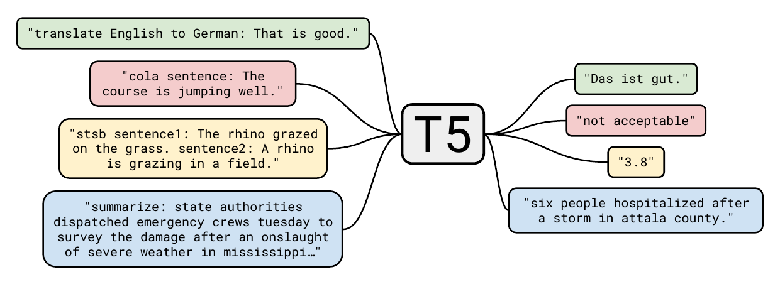
T5: Everything Is Text-to-Text
One model, one format — task instructions live inside the input text
Figure 1: Raffel et al. (2020), “Exploring the Limits of Transfer Learning… (T5)”, arXiv:1910.10683
Full encoder–decoder transformer: reads with an encoder (like BERT), writes with a decoder (like GPT).
Translation, summarization, classification, even regression (“3.8”) — all become: text in → text out.
Pretrained with span corruption — mask whole spans, generate them back. A prompt-based view before prompting was cool.
Session 24 · Language Models
15

Slide 16
GPT vs BERT vs T5
Three architectures, three objectives, three sweet spots
 | GPT | BERT | T5
Architecture | Decoder only | Encoder only | Encoder + Decoder
Objective | Next-token prediction | Masked words (+NSP) | Span corruption
Attention | Causal (left-only) | Bidirectional | Bi (enc) + causal (dec)
Can generate? | Yes — its whole job | No | Yes
Best at | Writing, chat, code | Understanding, classification, search | Translation, summarization
Descendants | GPT-3/4, ChatGPT, Claude, Llama | RoBERTa, DistilBERT, ALBERT | FLAN-T5, BART (cousin)
Session 24 · Language Models
16

Slide 17
Twenty Years in One Line
From counting bigrams to conversational AI
1990s
2003
2017
2018
2019–20
2022+
N-grams rule
Counting-based LMs power speech & MT
Transformer
“Attention Is All You Need”
GPT-2, T5, GPT-3
Scale unlocks generation & few-shot
Neural LM
Bengio: embeddings + neural nets
GPT & BERT
Pretrain-then-finetune era begins
ChatGPT era
Instruction tuning + RLHF → assistants
Session 24 · Language Models
17

Slide 18
Recap: What to Remember
If you keep only five ideas from today, keep these
1
A language model predicts words — Everything else — GPT, BERT, T5 — is a strategy for doing this better.
2
N-grams: count → hit three walls — Sparsity, no generalization, tiny context.
3
Neural LMs: represent → generalize — Bengio 2003: embeddings + a network, learned together.
4
Autoregressive (GPT): predict the NEXT token — Left-to-right, causal attention → born to generate.
5
Masked (BERT): predict the MISSING token — Bidirectional → born to understand. T5 unifies both as text-to-text.
Session 24 · Language Models
18

Slide 19
NEXT UP
Large Language Models in Practice
Using pretrained models with Hugging Face — generation, fill-mask, and fine-tuning on your own data.
Questions to think about before next time:
Why can't BERT write an essay, even though it “knows” more context than GPT?
If next-token prediction is so simple, where does ChatGPT's apparent reasoning come from?
Session 24 · Language Models · Computer Vision & AI Course

